Slide 1
Annotating and Curating Data
BDK12-3 | Data annotation and Curation
Nicole Vasilevsky | OHSU Library – Ontology Development Group

Slide 2
The Research Life Cycle
EXPERIMENT
FUND
CONSULT
DEPOSIT
PUBLISH

Slide 3
The Research Life Cycle
Network
EXPERIMENT
FUND
CONSULT
DEPOSIT
PUBLISH

Slide 4

How do we handle all of this data?

Slide 5
Data curation: activities required to maintain research data long-term such that it is available for reuse and preservation.

Slide 6

The average amount of time scientists spend reading a single journal
Tenopir, C. and King, D.W. (2007), “Perceptions of value and value beyond perceptions: measuring the quality and value of journal article readings”, Serials, Vol. 20 No. 3, pp. 199-207.

Slide 7
The total number of articles that a scientist reads
Tenopir, C. and King, D.W. (2007), “Perceptions of value and value beyond perceptions: measuring the quality and value of journal article readings”, Serials, Vol. 20 No. 3, pp. 199-207.

Slide 8
How do we extract all this information out of the published literature?

Slide 9
Biocurators curate data and the literature
PUBLISH
DEPOSIT

Slide 10


Slide 11
Controlled vocabulary
A controlled vocabulary is an organized arrangement of words and phrases used to index content and/or to retrieve content through browsing or searching. It typically includes preferred and variant terms and has a defined scope or describes a specific domain.
C ntrolled vocabulary

Slide 12
Controlled vocabulary
Subject headings are a type of controlled vocabulary that contains a hierarchy of terms, used for classifying data.
Example: Medical Subject Headings

Slide 13
Controlled vocabulary
Ontologies are a formal conceptualization of a specified domain of interest.
Hierarchical terms are defined textually and logically
Relationships between the terms are defined
Expressed in a language that can be reasoned across by computers
Data can be reused and can be easily linked together

Slide 14
Ontology Examples
Ontology | Data type
Gene ontology (GO) | Genes and biological processes
Ontology for Biomedical Investigation (OBI) | Life science and clinical investigation
Disease Ontology | Human diseases
Uberon | Cross-species anatomy
Human phenotype ontology | Human phenotypes

Slide 15

Annotating data
A controlled vocabulary term is used to tag a piece of data

Slide 16
Annotating data
The goal of the annotation is to add value by enabling:
Indexing data
Linking data

Slide 17

Annotating data
Annotation of data makes it easier to find and group data via semantic search

Slide 18
Biocurators curate the literature
Model Organism Databases
Mouse Genome Informatics
Zebrafish Information Network
Rat Genome Database
Sequence Databases
Sequence
Databases
GenBank
Uniport
Immunological Databases
Immune Epitope Database
Antibody Registry
Epitome

Slide 19
Biocurators frequently report they need to contact authors for additional information

Slide 20
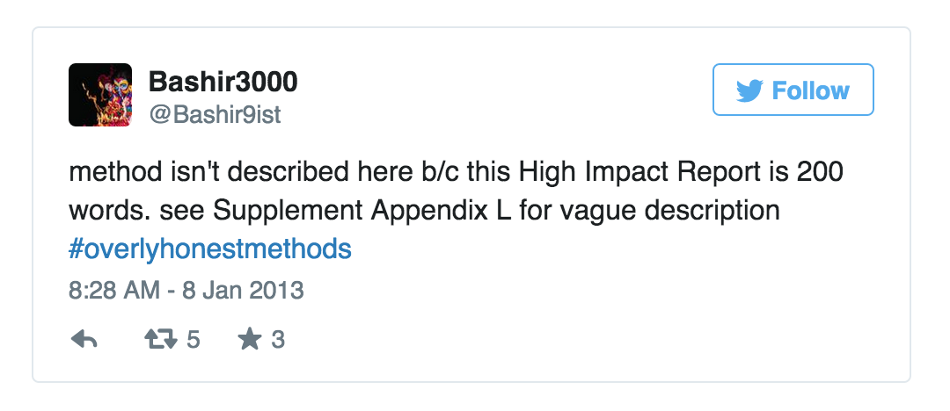
Well structured, annotated data does not always make it into the literature

Slide 21

Reporting of reagents

Slide 22
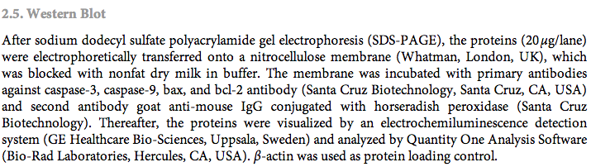
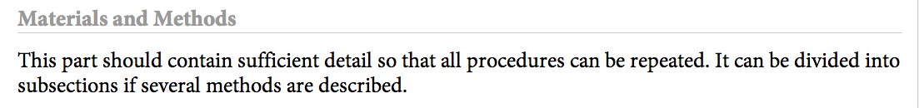
Reporting of reagents
Biomed Res Int. 2013;2013:350419.

Slide 23

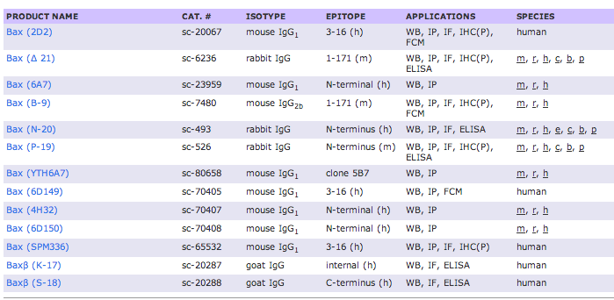
Reporting of reagents

Slide 24
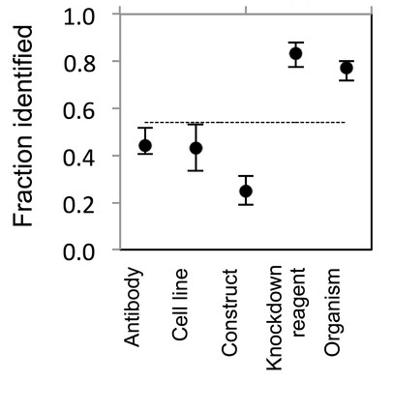
Research Resources are not uniquely identifiable in the published literature
https://peerj.com/articles/148/

Slide 25
Researchers can be curators too

Slide 26

How you can be a biocurator
Structure your data using controlled vocabularies or ontologies
Report unique identifiers in publications
Consult guidelines and data standards to determine minimal information to be reported about experiments

Slide 27
Structure your data using controlled vocabularies or ontologies

Slide 28

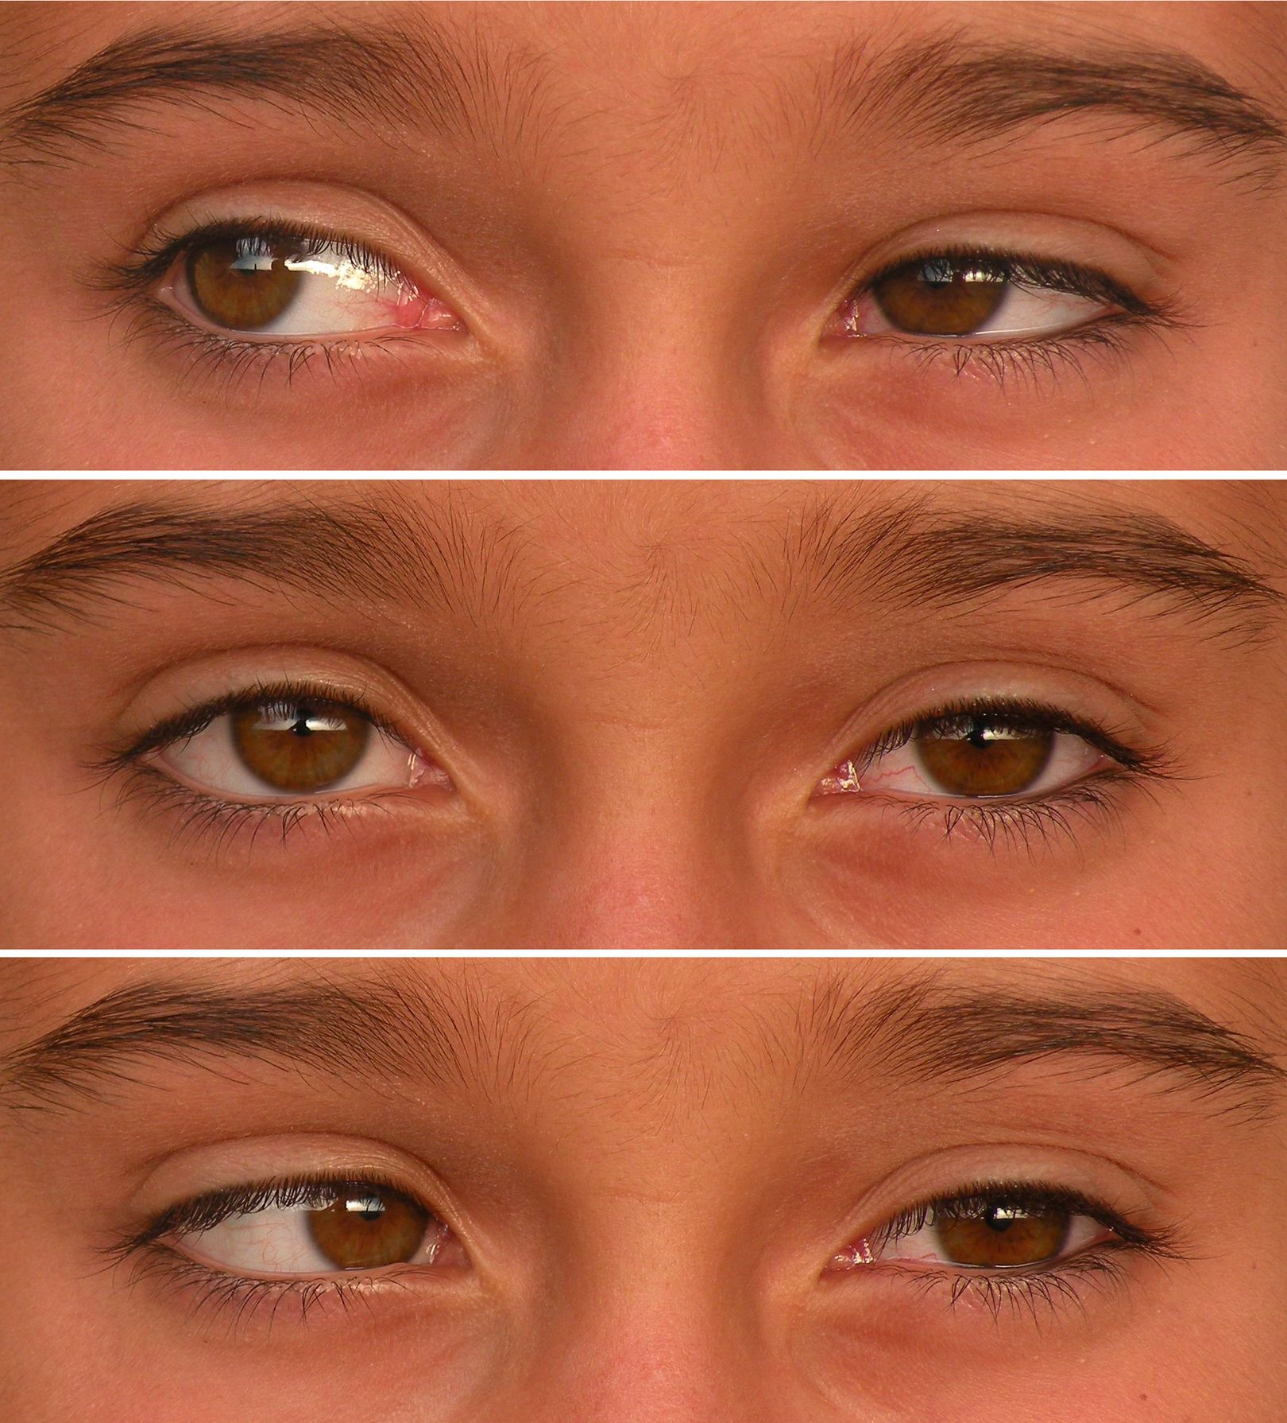
Human Phenotype Ontology
Provides standardized vocabularies of phenotypic abnormalities encountered in human diseases

Slide 29

phenotypic descriptions in human and animal studies
Background
The PAX6 protein is a member of the PAX (paired-box) family of transcriptional regulators and is essential for normal ocular and neural development [1]. Heterozygous mutations of the human PAX6 gene cause aniridia (absence of the iris) and a range of other congenital eye malformations [2]. Neural defects such as foveal hypoplasia and optic nerve hypoplasia are common in PAX6-associated eye disease [3-5]. Homozygous mutations in man and mouse are lethal and result in severe developmental abnormalities including anophthalmia, severe reduction of the olfactory structures and gross brain malformations [2,6]. The roles of PAX6 in brain development have mainly been studied in homozygous mutant mice or rats and include arealisation of the cerebral cortex [7], formation of the prosencephalon-mesencephalon boundary [8], axon guidance [8], differentiation of neurons from glia [9] and neuronal migration in the cerebellum [10].
HP_0007750
Hypoplasia of the fovea
HP_0000528
Anophthalmia
http://www.ncbi.nlm.nih.gov/pmc/articles/PMC1208879/

Slide 30
Report unique identifiers in publications

Slide 31
Unique identifiers
Any identifier which is guaranteed to be unique among all identifiers used for those objects and for a specific purpose
Example:
Identifiers for genes in NCBI gene
Identifiers for antibodies in the Antibody Registry
https://en.wikipedia.org/wiki/Unique_identifier

Slide 32
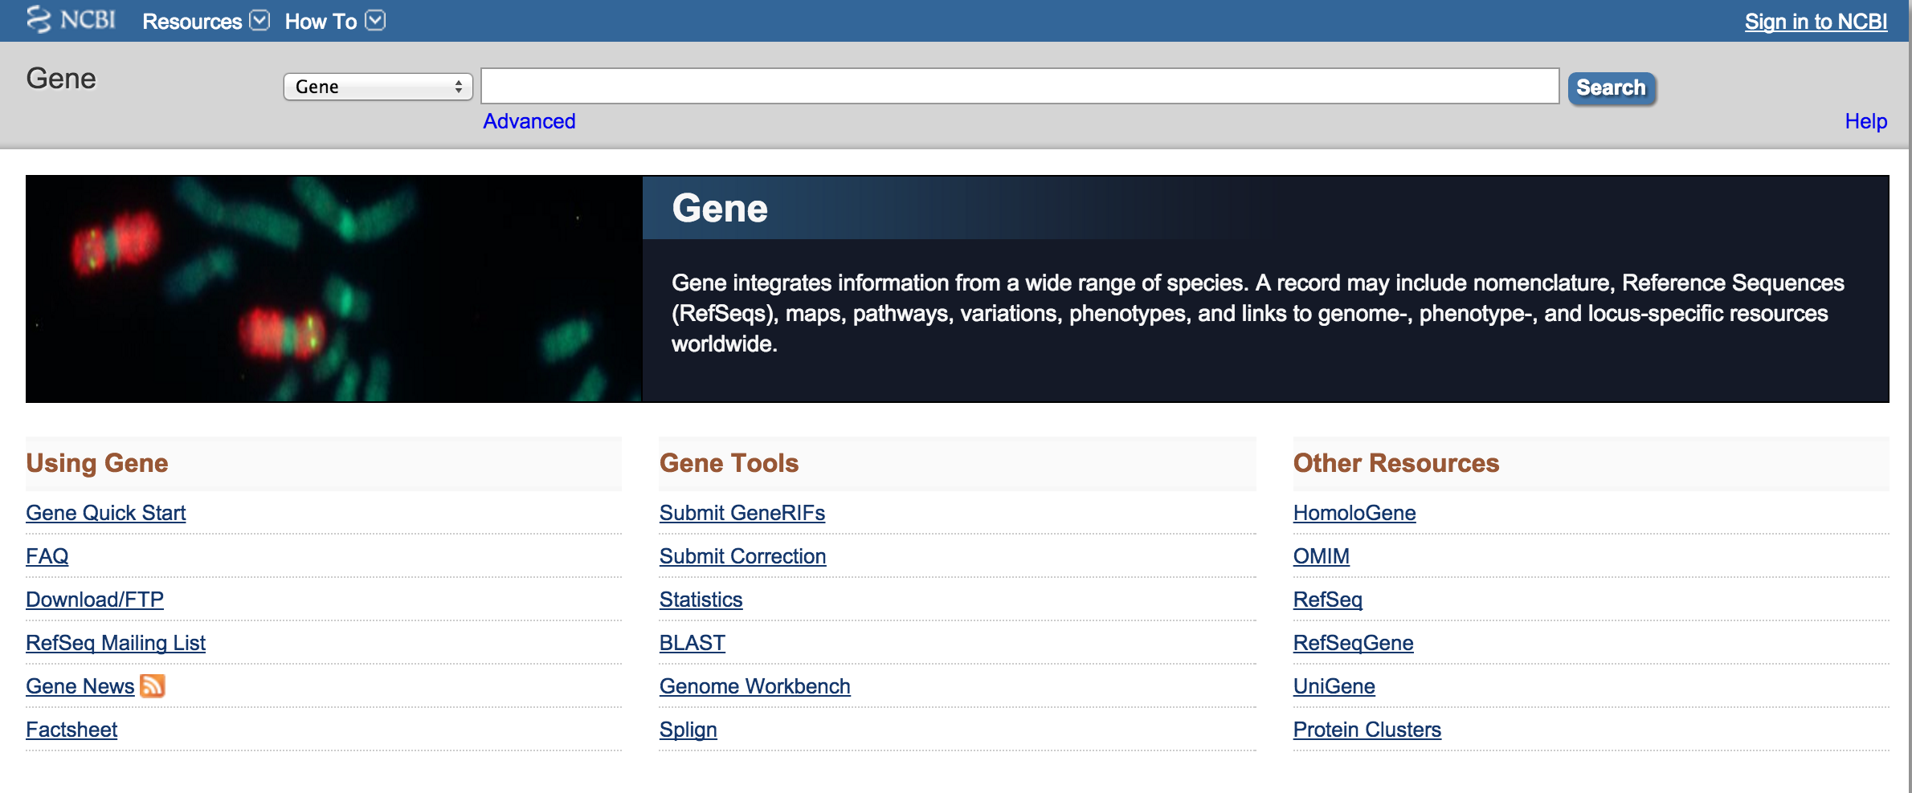
NCBI gene
http://www.ncbi.nlm.nih.gov/gene/

Slide 33
NCBI gene
Search for a gene name in the search bar here
You can search on the name and species to narrow down the results.
http://www.ncbi.nlm.nih.gov/gene/

Slide 34
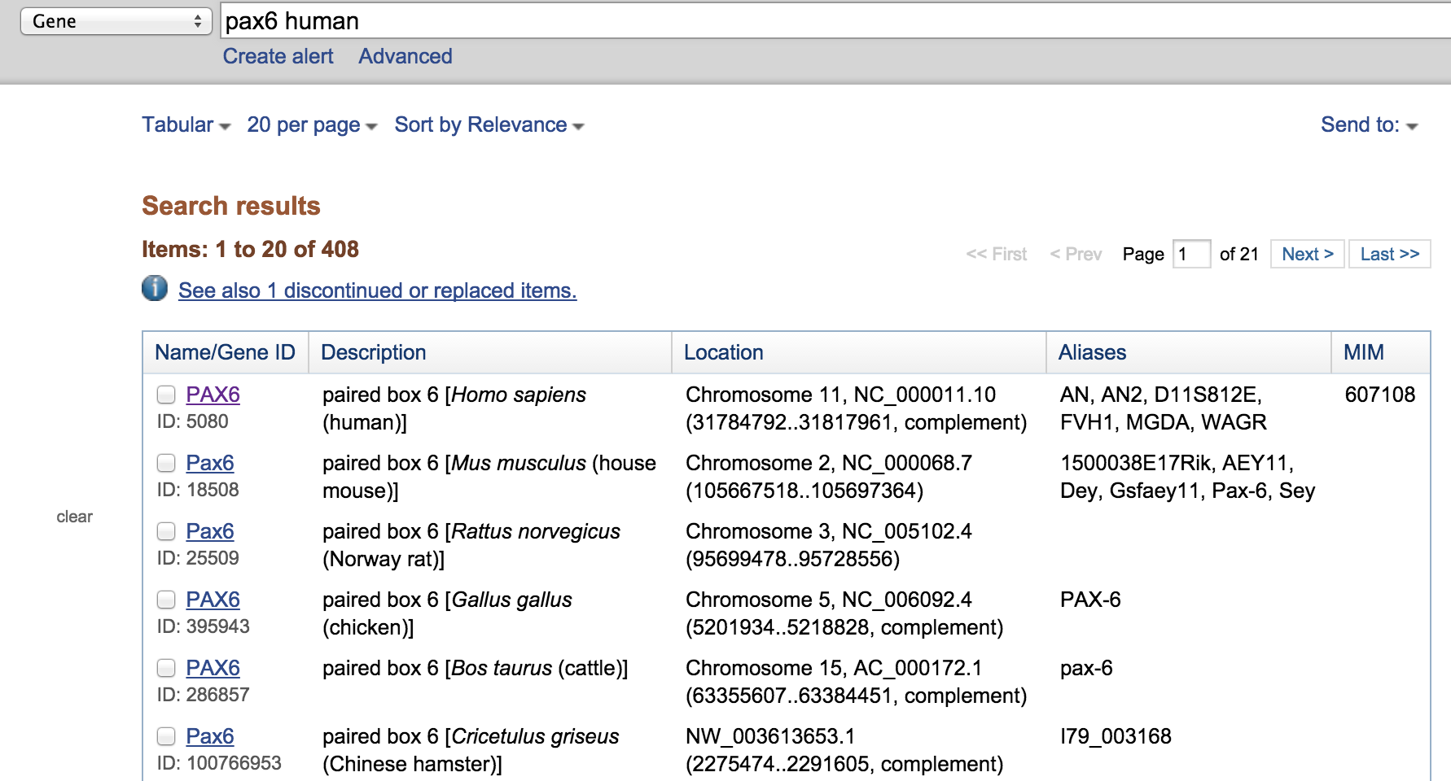
NCBI gene
If we search for Pax6 human, we get over 400 results
Information retrieved on 2016-02-25
http://www.ncbi.nlm.nih.gov/gene/

Slide 35
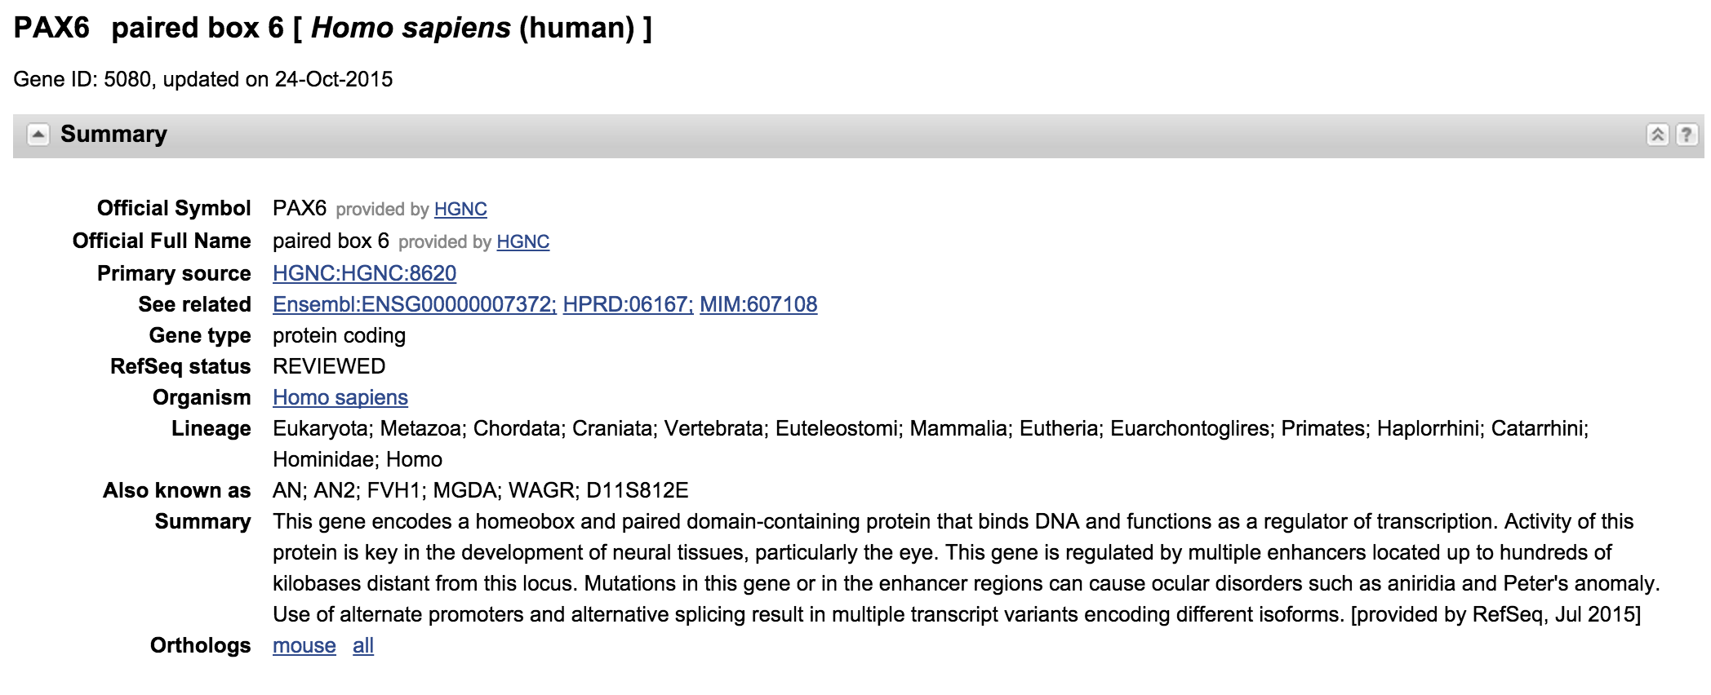
NCBI gene
http://www.ncbi.nlm.nih.gov/gene/

Slide 36
Consult guidelines and data standards to determine minimal information to be reported about experiments

Slide 37


Reporting guidelines for life science resources
https://www.force11.org/node/4433

Slide 38

International Society for Biocuration
http://biocuration.org/

Slide 39
Some biocuration methods can be automated

